Slide 1


Sales Forecasting Project
Presented by
Mohamed Sayed
Abdallah Ashraf
Mohamed Dyaa
Ismail Mahmoud
Abdelrahman Adel
Abdelrahman Fawad
Date: Friday, May 16, 2025

Slide 2
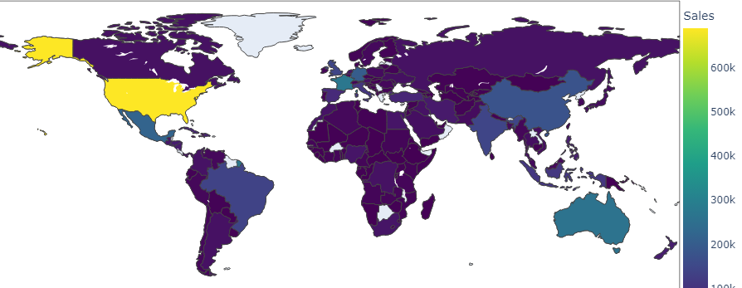
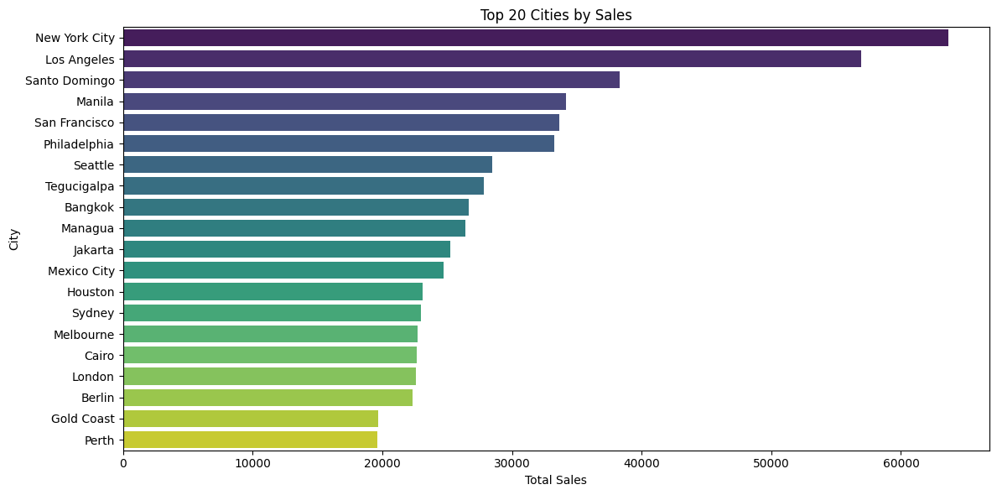
Project Idea
Problem
Solution
Businesses struggle with forecasting sales, leading to stock issues and revenue loss.
Use historical sales data (2011–2015) to build predictive models with Python.
Unique Value
Supports smarter inventory planning, targeted marketing, and increased profit.

Slide 3
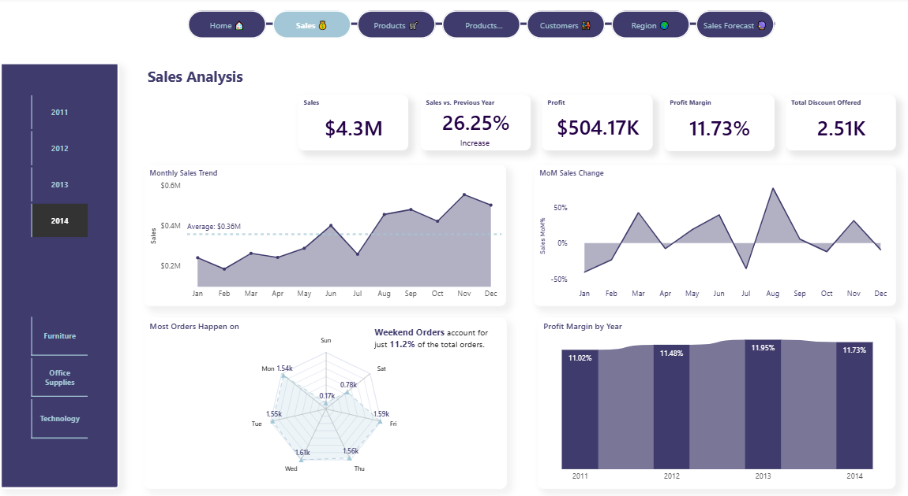
Project Wireframe
User Journey
1. Upload sales data (CSV)
2. Visualize trends and summaries
3. Generate future sales predictions
4. Download reports and insights

Slide 4

End Users
- Business analysts
- Marketing teams
- Inventory managers
Key Features
- Upload sales data
- View charts and insights
- Predict future sales
- Export reports

Slide 5
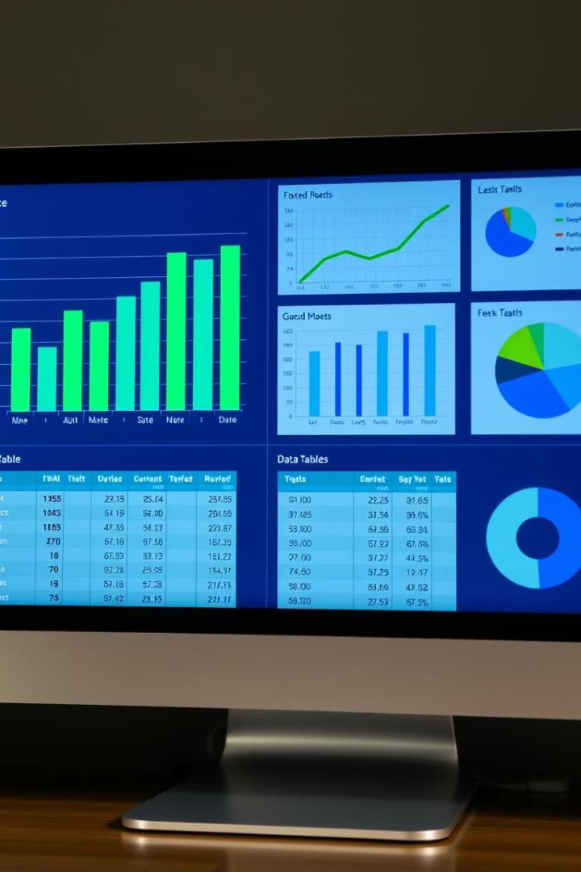
Data Structure
1- Dataset:
Superstore data (2011–2015), 24 columns, 51,290 rows
2- Structure:
Relational data – Orders, Products, Customers
3- Flow:
Raw data → Cleaning → Feature extraction → Forecasting model
4- Format:
The dataset is stored as a CSV file (superstore_dataset2011-2015.csv), encoded in ISO-8859-1, containing 24 columns and 51,290 rows.

Slide 6
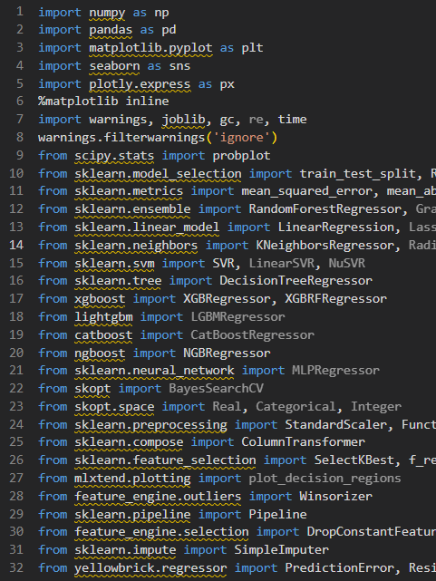
Technologies & Tools Used
1- Language: Python
2- Libraries: - Pandas, NumPy - Matplotlib, Seaborn,Plotly - Scikit-learn
3- Tools: -
Jupyter Notebook (data analysis & modeling)
Power BI (interactive dashboards & reports)
Git & GitHub (version control & code collaboration)

Slide 7
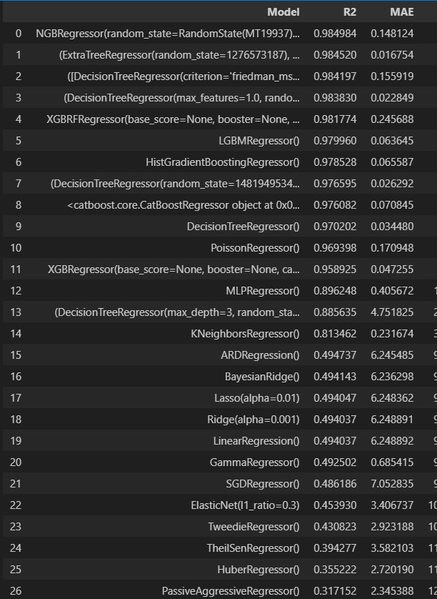
Live Prototype & Model Evaluation
Status:
Local prototype developed using Jupyter Notebook and Power BI.
Models Tested:
- ExtraTreesRegressor, RandomForest, NGBRegressor, XGBoost, SVR, KNN
Best Model:
ExtraTreesRegressor (R² = 0.984, MAE = 10.32, Training Time = 3.59s)
Testing:
Model evaluation based on R² score, MAE, and MSE using historical sales data.
Feedback:
Under internal team review and quality checks.

Slide 8

Deliverables
Final Deliverables:
- Cleaned dataset
- EDA report with charts
- Forecasting model
- PowerPoint presentation
- GitHub code repository
- Model comparison report with evaluation metrics table.

Slide 9
Team Members & Their Roles
Team Members:
Mohamed Diaa: Data analysis, Documentation
Mohamed Sayed: Exploratory data analysis ,Data cleaning
Abdallah Ashraf: model development ,Power Bi
Ismail Mahmoud: Presentation design, Power Bi
Abdelrahman Fawad: Data cleaning and feature engineering
Abdelrahman Adel: Model evaluation and testing
Communication Tools:
WhatsApp,
Google Docs,
GitHub,
linkedin

Slide 10
Thank you for your time!

